Slide 1
Programming fundamentals
Week 04 – Imperative programming
Course Instructor:
Engr.Asma Khan
Assistant Professor
SE,Dept

Slide 2
Strategy for nesting loop
This program will consist of several components.
We need an input() statement to read in the phrase, a for loop to iterate over the characters of the input string, and, in every iteration of the for loop, an if statement to check whether the current character is a vowel.
If so, it gets printed.
Next is the complete program.

Slide 3
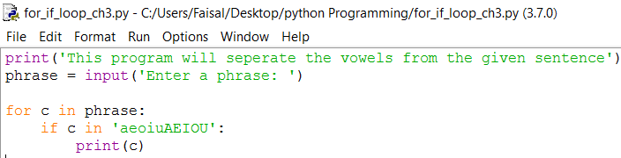
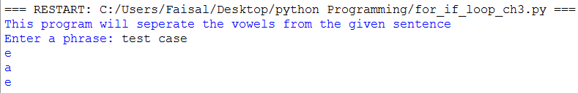
For loop with condition statement code and execution
Code with for loop and if condition
Executing the code using nesting loop

Slide 4
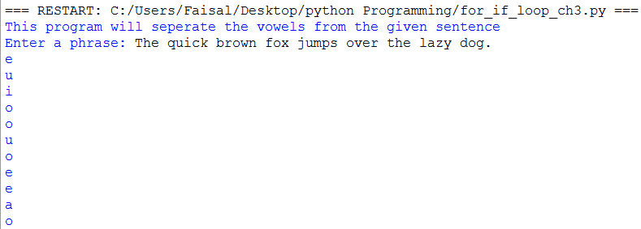
Another sentence for finding the vowels
Note that we combined a for loop and an if statement and that indentation is used to specify the body of each.
The if statement body is just print(c) while the for loop statement body is:
if c in 'aeiouAEIOU':
print(c)

Slide 5
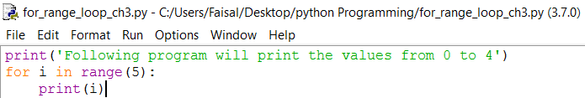
Function range()
We just saw how the for loop is used to iterate over the items of a list or the characters of a string. It is often necessary to iterate over a sequence of numbers in a given range, even if the list of numbers is not explicitly given. For example, we may be searching for a divisor of a number.
Or we could be iterating over the indexes 0, 1, 2, . . . of a sequence object. The built-in function range() can be used together with the for loop to iterate over a sequence of numbers in a given range. Here is how we can iterate over the integers 0, 1, 2, 3, 4:

Slide 6
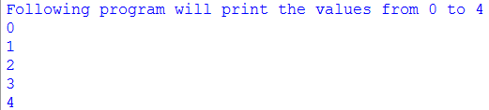
Function range()

Slide 7
Function range()
Function range(n) is typically used to iterate over the integer sequence 0, 1, 2, . . . , (n -1).
In the last example, variable i is set to 0 in the first iteration; in the following iterations, i gets assigned values 1, 2, 3, and finally 4 (as n = 5).
As in previous for loop examples, the indented code section of the for loop is executed in every iteration, for every value of i.

Slide 8
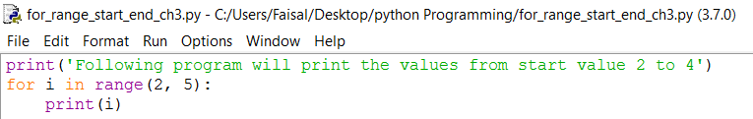
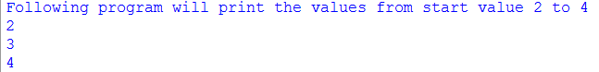
Function range(start, end)
The range() function can also be used to iterate over more complex sequences of numbers.
If we would like the sequence to start at a nonzero number start and end before number end, we make the function call range(start, end). For example, this for loop iterates over the sequence 2, 3, 4:

Slide 9
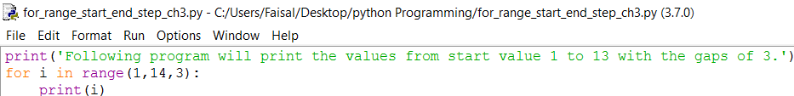
Function range(start, end, step)
In order to generate sequences that use a step size other than 1, a third argument can be used.
The function call range(start, end, step) can be used to iterate over the sequence of integers starting at start, using a step size of step and ending before end. For example, the next loop will iterate over the sequence 1, 4, 7, 10, 13:
The sequence printed by the for loop starts at 1, uses a step size of 3, and ends before 14.
Therefore it will print 1, 4, 7, 10, and 13.

Slide 10
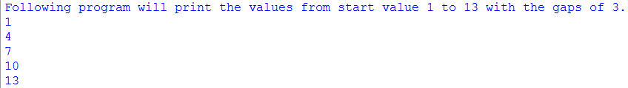
Function range(start, end, step) program execution

Slide 11
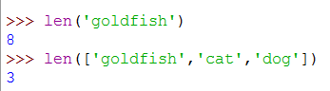
User-defined functions
We have already seen and used several built-in Python functions. The function len(), for example, takes a sequence (a string or a list, say) and returns the number of items in the sequence:
>>> len('goldfish')
8
>>> len(['goldfish', 'cat', 'dog'])
3
Function max() can take two numbers as input and returns the maximum of the two:
>>> max(4, 7)
7

Slide 12
User-defined functions
Function sum() can take a list of numbers as input and returns the sum of the numbers:
>>> sum([4, 5, 6, 7])
22
Some functions can even be called without arguments:
>>> print()
In general, a function takes 0 or more input arguments and returns a result.
One of the useful things about functions is that they can be called, using a single-line statement, to complete a task that really requires multiple Python statements.

Slide 13
Our first function
We illustrate how functions are defined in Python by developing a Python function named f that takes a number x as input and computes and returns the value x2 +1.We expect this function to behave like this:
>>> f(9)
82
>>> 3 * f(3) + 4
34
Argument for f
f(argument)
Return from function f
Argument for f
f(argument)
{code to be executed}
Return from function f

Slide 14
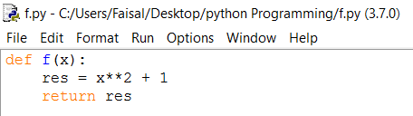
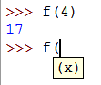
Coding for the user-defined function
Function f() can be defined in a Python module as:
Argument for f
f(argument)
Return from function f
def f(4):
res = 4**2 + 1
return res
Argument for f (4)
res from function f -> 17

Slide 15
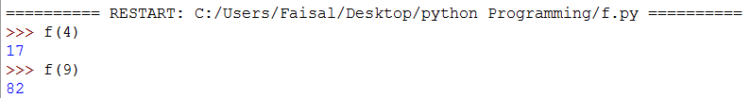

User-defined function execution
3*f(3)+4
Expression using function f(x)
res from function f(3) used in Expression
def f(x):
res = x**2 + 1
return res

Slide 16
User-defined function general format
After you have defined function f(), you can use it just like any other built-in function. The Python function definition statement has this general format:
def <function name> (<0 or more variables>):
<indented function body>
A function definition statement starts with the def keyword. Following it is the name of the function; in our example, the name is f.
Following the name and in parentheses are the variable names that stand in for the input arguments, if any.
In function f(), the x in
def f(x):
has the same role as x in the math function f(x): to serve as the name for the input value.

Slide 17

User-defined function with two parameters
To define a function with more than one argument, we need to have a distinct variable name for every input argument.
For example, if we want to define a function called squareSum() that takes two numbers x and y as input and returns the $Sum of their squares=x^{2}+y^{2}$, we need to define function squareSum() so there is a variable name for input argument x, say x, and another variable name for input argument y, say y:

Slide 18
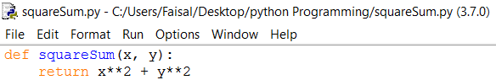
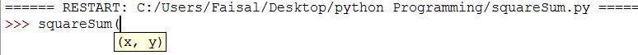
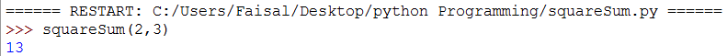
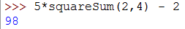


User-defined function with two parameters
SquareSum
$$x^{2}$$
+
$$y^{2}$$

Slide 19
Print( ) verses return
As another example of a user-defined function, we develop a personalized hello() function.
It takes as input a name (a string) and prints a greeting:
>>> hello(‘Faisal')
Hello, Faisal!
We implement this function in the same module as function f():
def hello(name):
print('Hello, '+ name + '!')

Slide 20
Print( ) verses return
When function hello() is called, it will print the concatenation of string 'Hello, ', the input string, and string '!'.
Note that function hello() prints output on the screen; it does not return anything.
What is the difference between a function calling print() or returning a value?

Slide 21
Statement return versus Function print( )
!
A common mistake is to use the print() function instead of the return statement inside a function.
Suppose we had defined our first function f() in this way:
def f(x):
print(x**2 + 1)
It would seem that such an implementation of function f() works fine:
>>> f(2)
5
However, when used in an expression, function f() will not work as expected:
>>> 3 * f(2) + 1
5
Traceback (most recent call last):
File '<pyshell#103>', line 1, in <module>
3 * f(2) + 1
TypeError: unsupported operand type(s) for *:
'int' and 'NoneType‘
Actually, Python has a name for the “nothing” type: It is the 'NoneType' referred to in the error message shown.
The error itself is caused by the attempt to multiply an integer value with “nothing.”

Slide 22
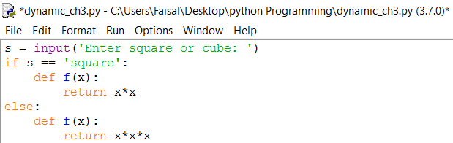
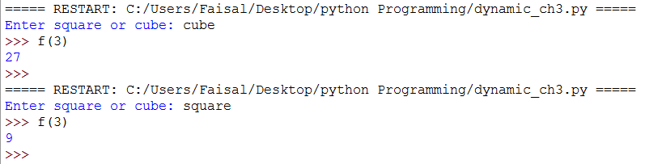
Function definitions are “assignment” statements

Slide 23
First Define the Function, Then Use It
!
Python does not allow calling a function before it is defined, just as a variable cannot be used in an expression before it is assigned.
Knowing this, try to figure out why running this module would result in an error:
print(f(3))
def f(x):
return x**2 + 1
Answer: When a module is executed, the Python statements are executed top to bottom. The print(f(3)) statement will fail because the name f is not defined yet.

Slide 24
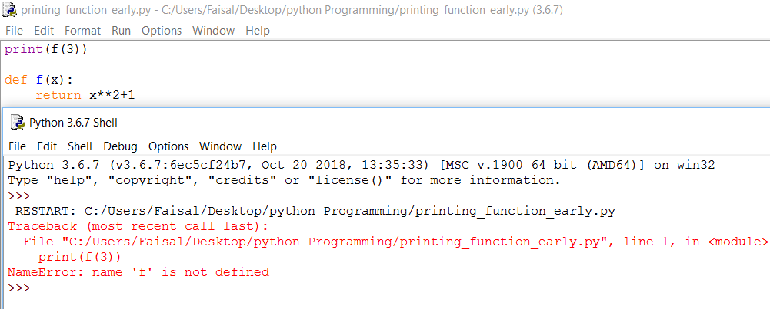
Calling function before initialization

Slide 25
Analyzing the code
Will we get an error when running this module?
def g(x):
return f(x)
def f(x):
return x**2 + 1
Answer: No, because functions f() and g() are not executed when the module is run, they are just defined. After they are defined, they can both be executed without problems.

Slide 26
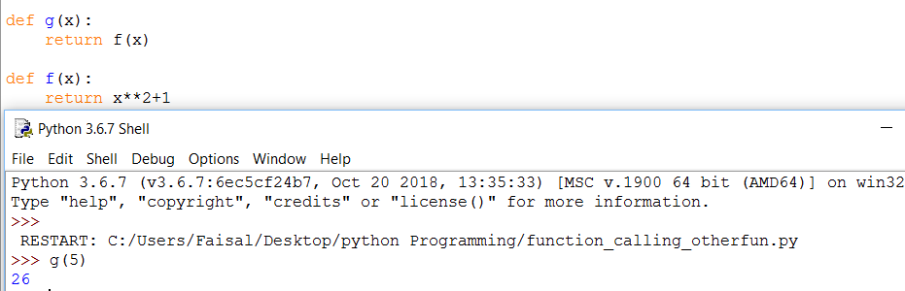
Function returning other function

Slide 27
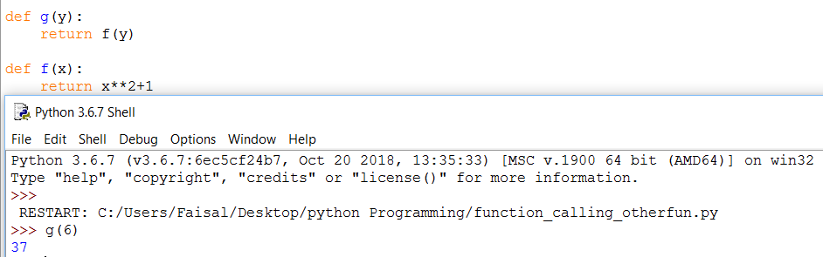
Function using different variable

Slide 28
Comments – Single line comment by #
Python programs should be well documented for two reasons:
1. The user of the program should understand what the program does.
2. The developer who develops and/or maintains the code should understand how the program works.
def f(x):
res = x**2 + 1 # compute x**2 + 1 and store value in res
return res # return value of res

Slide 29
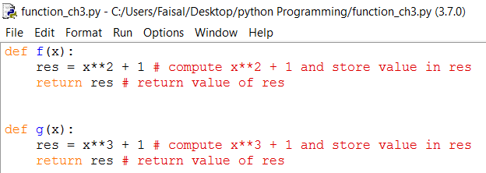
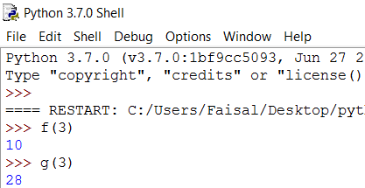
Comments – multiline comment by “””
In Python multiline comments are also used during the time of debugging and restricting a single block of code.
For multiline comments we use “”” , 3 time double quotes.

Slide 30
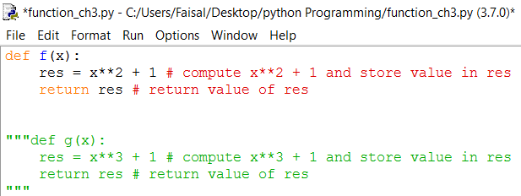
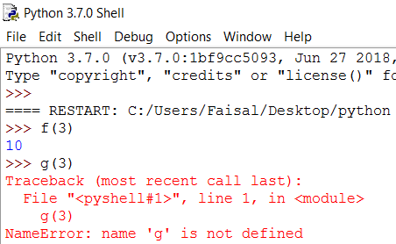
Execution of function g( ) blocked
As we have used multiline comment on function g( ), It will not interpreted and when calling the function it will generate the error.

Slide 31
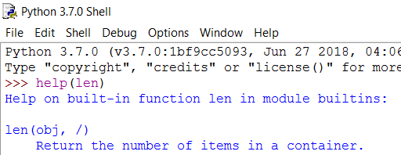
Docstrings
Functions should also be documented for the function users. The built-in functions we have seen so far all have documentation that can be viewed using function help(). For example:
>>> help(len)
Help on built-in function len in module builtins:
len(...)
len(object) -> integer
Return the number of items of a sequence or mapping.

Slide 32
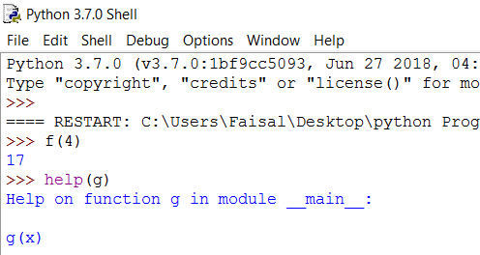
docstrings
If we use help on our first function g(), surprisingly we get some documentation as well.
>>> help(g)
Help on function f in module __main__:
f(x)

Slide 33
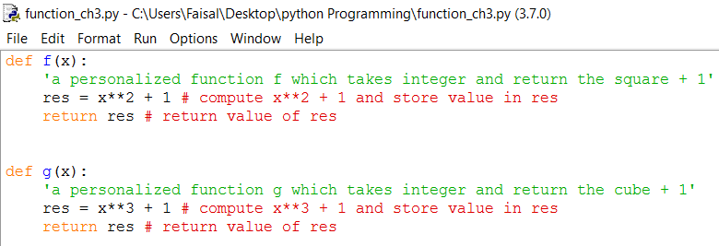
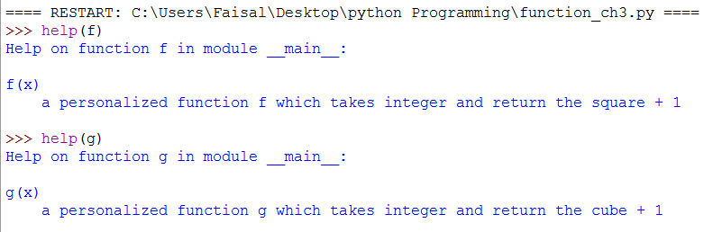
docstrings

Slide 34
Assignment # 3
To be submitted by solving it on python idle & email it to me. Remember to read chapter 3

Slide 35
Practice problem 3.1
Translate these conditional statements into Python if statements:
(a) If age is greater 62, print 'You can get your pension benefits'.
(b) If name is in list ['Musial', 'Aaraon', 'Williams', 'Gehrig', 'Ruth'],
print 'One of the top 5 baseball players, ever!'.
(c) If hits is greater than 10 and shield is 0, print 'You are dead...'.
(d) If at least one of the Boolean variables north, south, east, and west is True, print
'I can escape.'.

Slide 36
Practice problem 3.3
Translate these into Python if/else statements:
(a) If year is divisible by 4, print 'Could be a leap year.'; otherwise print 'Definitely not
a leap year.'
(b) If list ticket is equal to list lottery, print 'You won!'; else print 'Better luck next
time...'

Slide 37
Practice problem 3.4
Implement a program that starts by asking the user to enter a login id (i.e., a string). The program then checks whether the id entered by the user is in the list ['joe', 'sue', 'hani', 'sophie'] of valid users. Depending on the outcome, an appropriate message should be printed. Regardless of the outcome, your function should print 'Done.' before terminating. Here is an example of a successful login:
Login: joe
You are in!
Done.
And here is one that is not:
>>>
Login: john
User unknown.
Done.

Slide 38
Practice problem 3.5
Implement a program that requests from the user a list of words (i.e., strings) and then prints on the screen, one per line, all four-letter strings in the list.
>>>
Enter word list: ['stop', 'desktop', 'top', 'post']
stop
post

Slide 39
Practice problem 3.6
Write the for loop that will print these sequences of numbers, one per line, in the interactive shell.
(a) Integers from 0 to 9 (i.e., 0, 1, 2, 3, 4, 5, 6, 7, 8, 9)
(b) Integers from 0 to 1 (i.e., 0, 1)

Slide 40
Practice problem 3.7
Write the for loop that will print the following sequences of numbers, one per line.
(a) Integers from 3 up to and including 12
(b) Integers from 0 up to but not including 9, but with a step of 2 instead of the default
of 1 (i.e., 0, 2, 4, 6, 8)
(c) Integers from 0 up to but not including 24 with a step of 3
(d) Integers from 3 up to but not including 12 with a step of 5

Slide 41
Practice problem 3.8
Define, directly in the interactive shell, function perimeter() that takes, as input, the radius of a circle (a nonnegative number) and returns the perimeter of the circle. A sample usage is:
>>> perimeter(1)
6.283185307179586
>>> perimeter (2)
12.566370614359172
Remember that you will need the value of (defined in module math) to compute theperimeter.

Slide 42
Practice problem 3.9
Implement function average() that takes two numbers as input and returns the average of the numbers. You should write your implementation in a module you will name average.py.
A sample usage is:
>>> average(1,3)
2.0
>>> average(2, 3.5)
2.75

Slide 43
Practice Problem 3.10
Implement function noVowel() that takes a string s as input and returns True if no character in s is a vowel, and False otherwise (i.e., some character in s is a vowel).
>>> noVowel('crypt')
True
>>> noVowel('cwm')
True
>>> noVowel('car')
False

Slide 44
Practice problem 3.11
Implement function allEven() that takes a list of integers and returns True if all integers in the list are even, and False otherwise.
>>> allEven([8, 0, -2, 4, -6, 10])
True
>>> allEven([8, 0, -1, 4, -6, 10])
False

Slide 45
Practice problem 3.12
Write function negatives() that takes a list as input and prints, one per line, the negative values in the list.
The function should not return anything.
>>> negatives([4, 0, -1, -3, 6, -9])
-1
-3
-9

Slide 46
Practice problem 3.13
Add appropriate docstrings to functions average() and negatives() from Practice Problems 3.9 and 3.12. Check your work using the help() documentation tool. You should get, for example:
>>> help(average)
Help on function average in module __main__:
average(x, y)
returns average of x and y

Slide 47
1st Detailed assignment
To be solved and get printout , properly submitted in a file. (Before 5:00 PM,16 Nov 2018)

